Slide 1

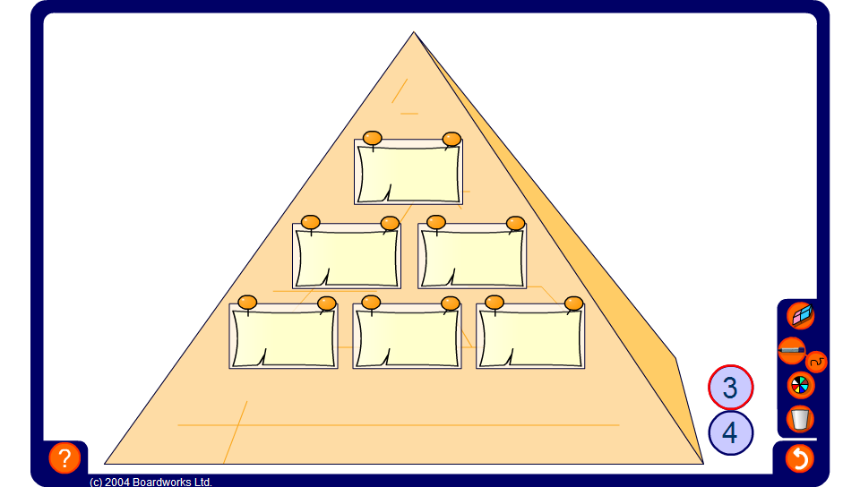


Addition pyramid
Notes:
Use mental methods to find the hidden values in the pyramid. Reveal the numbers on the bottom row to practise addition or reveal one or two numbers from each row to practise addition and subtraction.

